Slide 1
The Management Challenge
Week 3

Slide 2
Global Environment

Slide 3
The International Business Environment
“International Management is the management of business operations conducted in more than one country.”
Basic management functions remain the same, but with greater risks and difficulties.

Slide 4
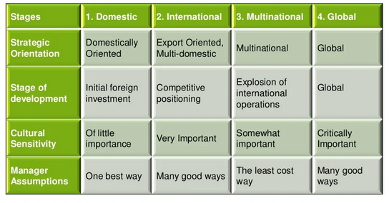

Slide 5
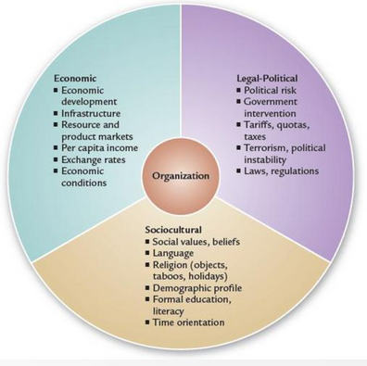

Slide 6
Economic Environment
“The economic environment represents the economic conditions in the country where the international organization operates.
Economic development
Infrastructure
Resource and product markets
Exchange rates
Inflation
Interest rates
Economic growth

Slide 7
1.1 Economic Development
Economic Development: Countries are categorized as either developed or developing (Less-developed/ LDCs) based on per capita income.
Per capita income is the income generated by the nation’s production of goods and services divided by total population.

Slide 8
1.2 Infrastructure
A country’s physical facilities that support economic activities.
Transportation facilities
Energy producing facilities
Communication facilities
Helping countries develop their infrastructure often falls on the shoulders of international agencies (e.g.World Bank).

Slide 9
1.3 Resource and Product Markets
Market analysis is required to identify the market demand for the products.
Choice between exporting product or building a plant.
What would be required to develop a plant?
Notes:
Resource markets for raw material and labour

Slide 10
1.4 Exchange Rates
Exchange rate is the rate at which one country’s currency is exchanged for another country’s.
Changes in rates affects profitability, as dollars get converted into foreign currencies.

Slide 11
Legal-Political Environment
Businesses must deal with unfamiliar political systems when they go international.
Government supervision and regulation
Viewed with suspicion as ‘outsiders’

Slide 12
2.1 Political Risk & Instability
Political risk is defined as the risk of lost assets, earning power, or managerial control due to politically based events or actions by host governments.
Political instability includes events like riots, revolutions, civil disorders, and frequent changes in government.

Slide 13
2.2 Laws & Regulations
Laws and regulations differ from country to country, creating a challenge for international firms.
Laws concern libel statutes, consumer protection, information and labelling, employment and safety, wages, etc.
Most visible changes grow out of international trade agreements and emerging international trade alliance system;

Slide 14
General Agreement on Tariffs and Trade (GATT)
23 nations in 1947, a set of rules for fair trade
World Trade Organization (WTO)
Maturation of GATT into permanent global institute
European Union (EU)
1957 alliance to improve economic and social conditions among members; evolved to 27-nation European Union
North American Free Trade Agreement (NAFTA)
Merged the US, Canada and Mexico into a single market

Slide 15
Socio-cultural Environment
Cultural factors are more perplexing than political and economic factors in foreign countries; as it is intangible, pervasive and difficult to learn.

Slide 16
3.1 Social Values
Geert Hofstede’s four dimensions:
Power distance: The degree to which people accept inequality of power among institutions, organizations, and people/
Uncertainty avoidance:value characterized by people’s intolerance of uncertainty and ambiguity and resulting in support for beliefs that promis certainty and uniformity.
Individualism & Collectivism: preference for loosely knit social framework where individuals are expected to take care of themselves, versus tightly knit social framework where individuals look after one another and organizations protect their member’s interests.
Masculinity/femininity: cultural preference for heroism, assertiveness, work centrality and material succcss versus cultural preference for cooperation, group decision making, and quality of life.
Long term/Short term: greater concern for the future and high value on thrift and perseverance versus concern with past and present and a hig value on making social obligations

Slide 17
Other cultural characteristics
Language
Religion
Attitudes
Social organization
Education
Ethnocentrism, a cultural attitude marked by the tendency to regard one’s own culture as superior to others, can make it difficult for foreign countries to operate.

Slide 18
Going International
Global Outsourcing: Engaging in international division of labour so as to obtain the cheapest sources of labour and supplies regardless of country (also called global sourcing).
E.g. mexican maquiladora industry

Slide 19
Going International
Market entry strategy: An organizational strategy for entering a foreign market.
Exporting: Market entry strategy in which the organization retains its production facilities within its home country and transfers its products for sale in foreign countries.
Licensing/ franchising: An entry strategy in which an organization in one country makes certain resources available to companies in another to participate in the production and sale of its products abroad.
Franchising is a form of licensing in which an organization provides its foreign franchisee with a complete package of materials and services.

Slide 20
Going International
Market entry strategy: An organizational strategy for entering a foreign market.
C. Direct Investment: an entry strategy in which the organization is involved in managing its production facilities in a foreign country.
D. Joint venture: a variation of direct involvement in which an organization shares costs and risks with another firm to build a manufacturing facility, develop new products, or set up a sales and distribution network.

Slide 21
Multinational Corporations (MNC)
An organization that receives more than 25% of its total sales revenues from operations outside the parent company’s home country; also called global corporation.
MNCs can move a wealth of assets from country to country and influence national economies, politics, and cultures.

Slide 22
Global Managers
Culture shock: Feelings of confusion, disorientation, and anxiety that result from being immersed in a foreign culture.
Cross-cultural management
Leading
Decision making
Motivating
controlling

